Slide 1
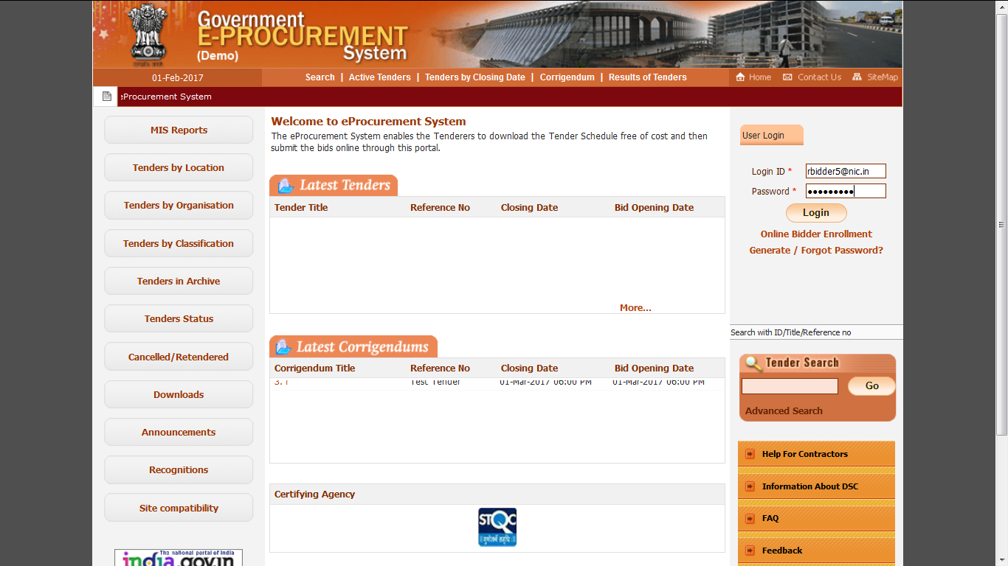
Bidder logs in using login ID and Password

Slide 2
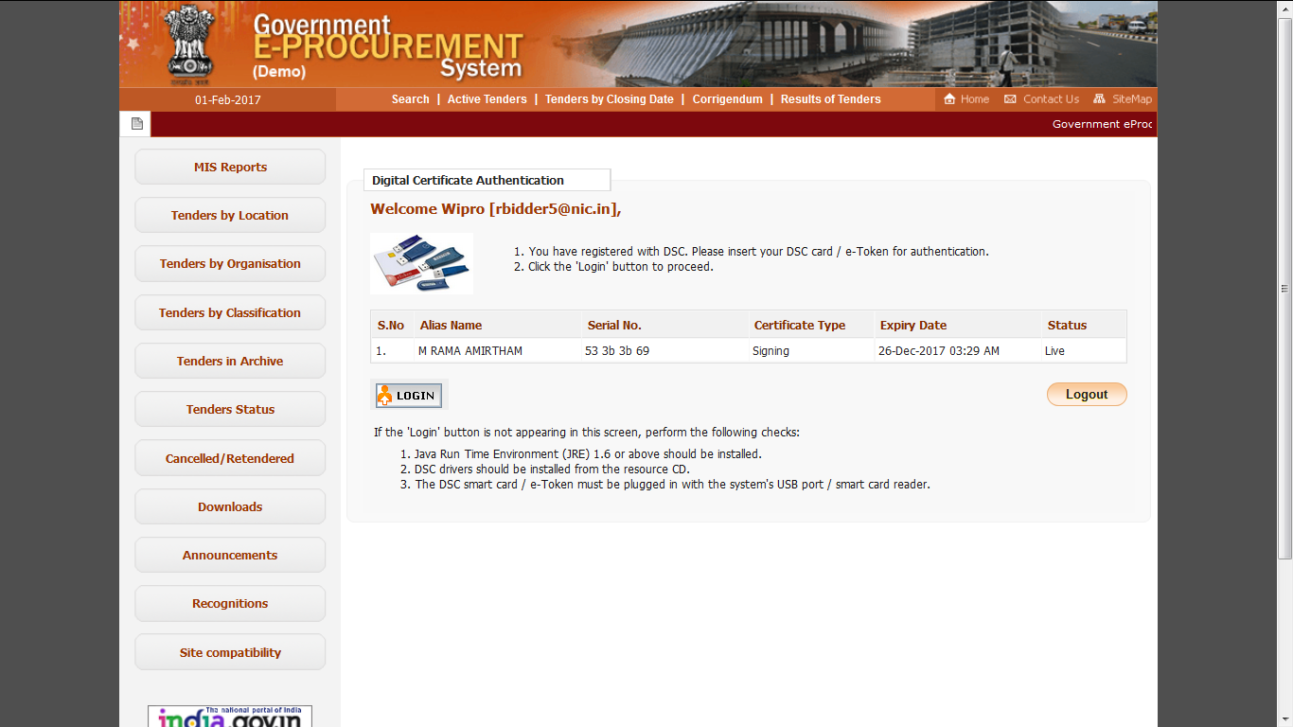
Click Login Button using DSC
Physically insert the eToken/Smartcard containing DSC into the system before clicking on Login Button. When prompted enter the DSC PIN also.

Slide 3
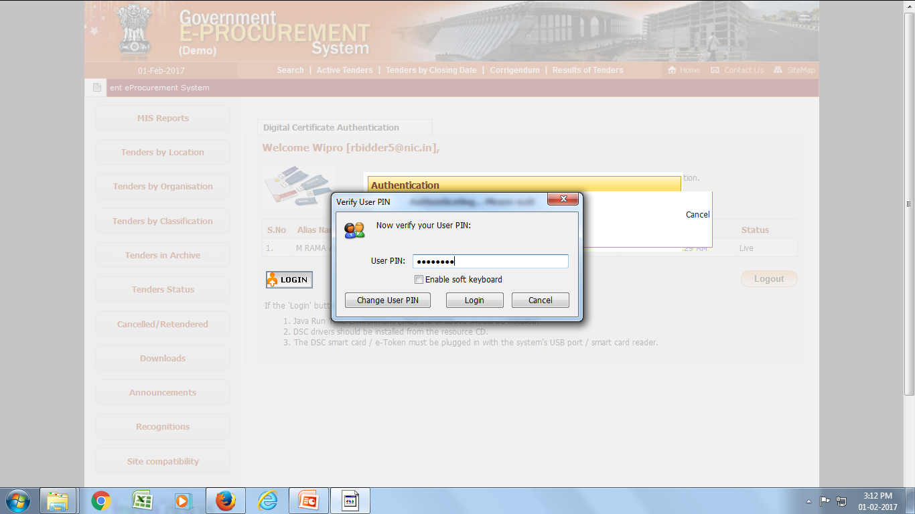
Enter DSC Password

Slide 4
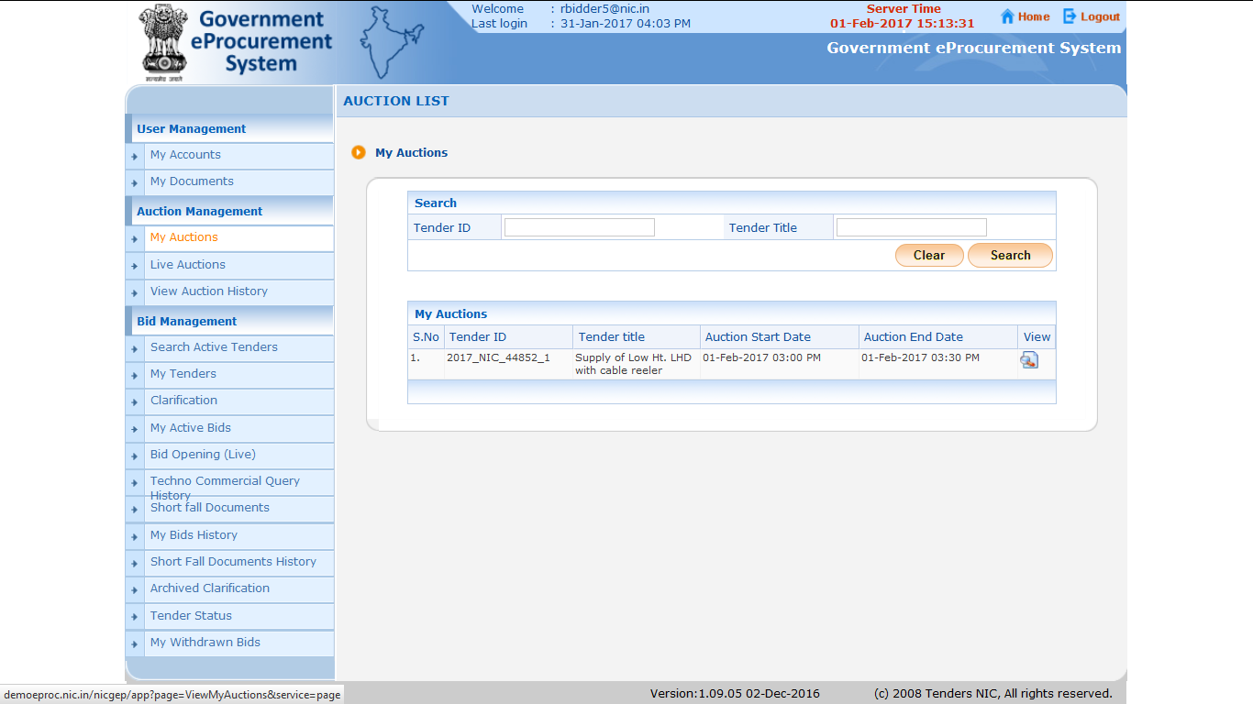
1. Click on My Auctions to view Action details for which Techno-Commercially qualified.
2. Click to view Auction details for participation

Slide 5
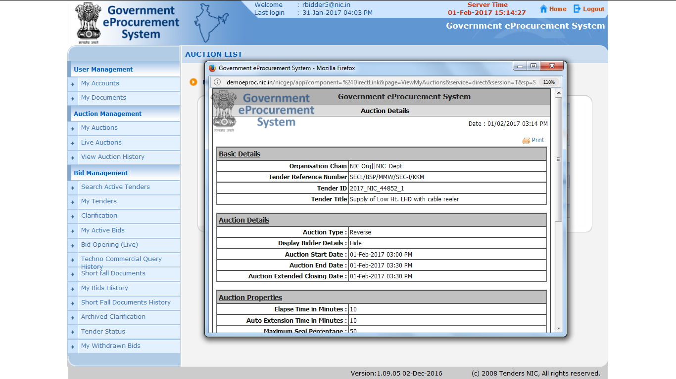
Published Auction Details

Slide 6
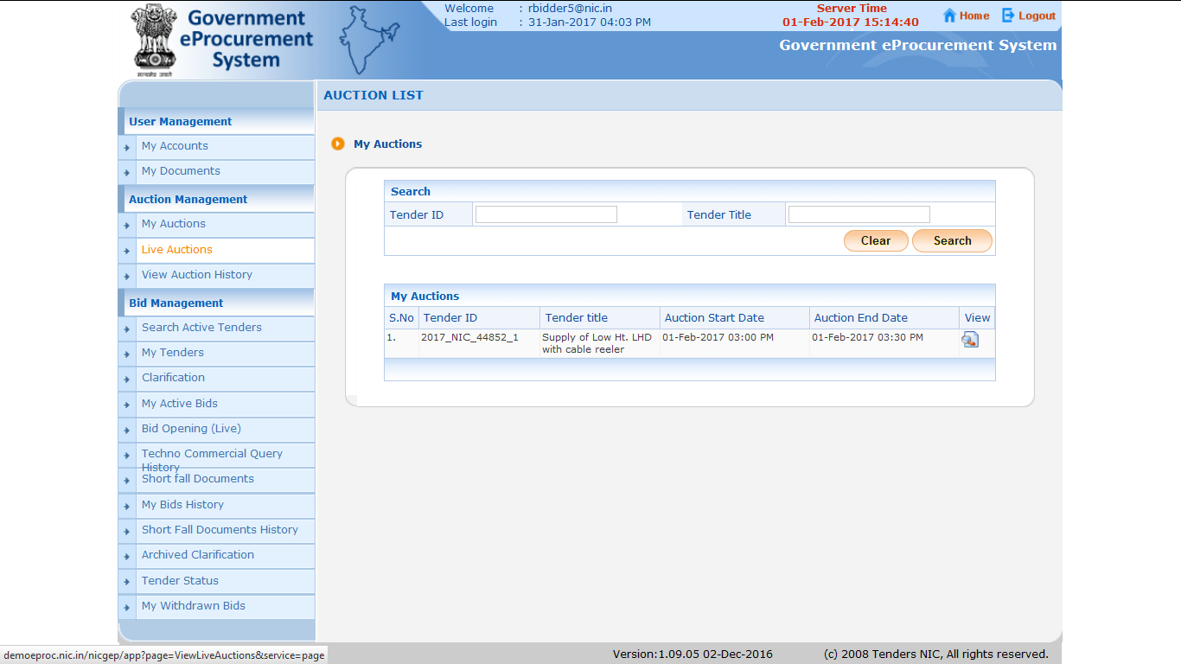
Click on Live Auctions to participate in the Auction/ Lot

Slide 7
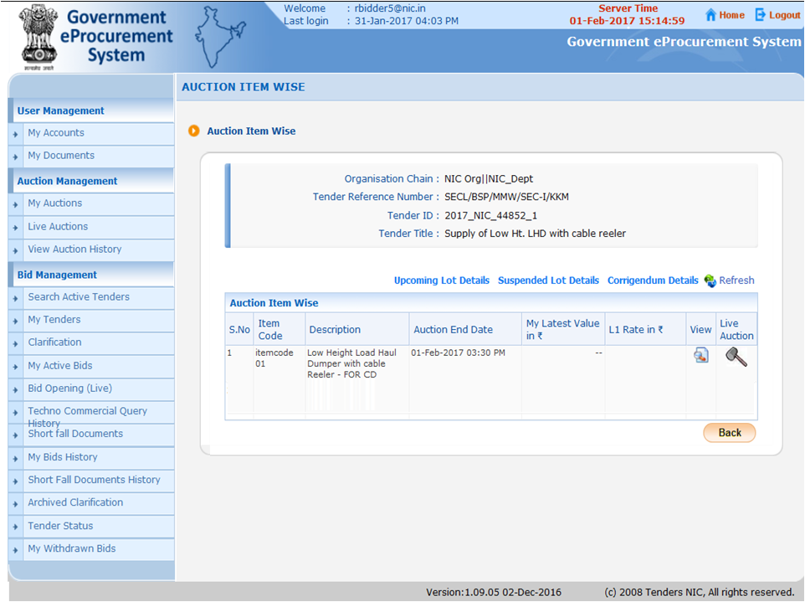
List of qualified Auction/Lots in which Bidder can participate

Slide 8
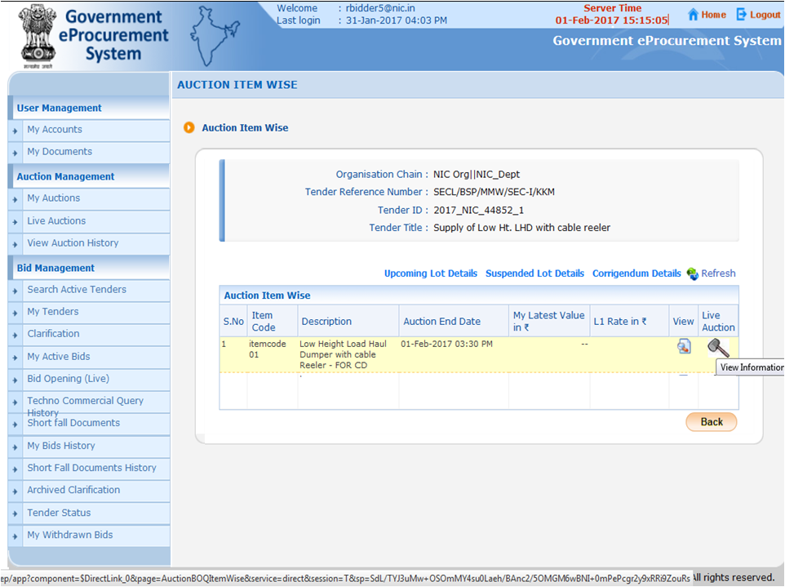
Click on Hammer Icon to participate in respective Lot

Slide 9
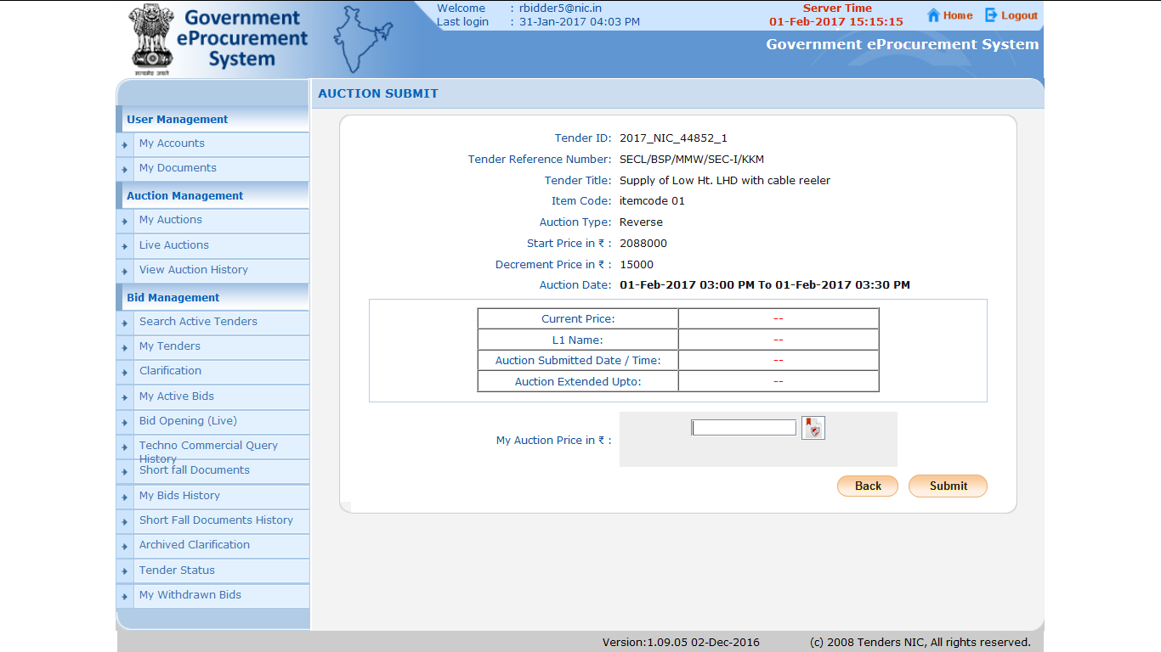
As no bidder has quoted his Rate for this Lot, Current Price is coming as Blank

Slide 10
2. Sign it Digitally by clicking on Sign Icon
1. Mention your Price

Slide 11
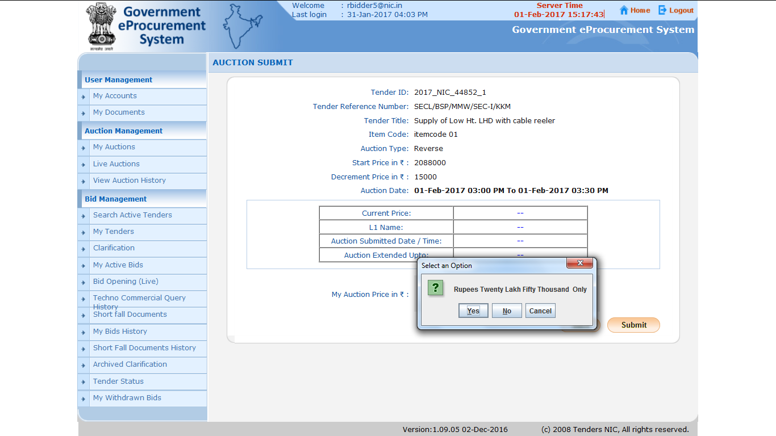
Click on ‘Yes’

Slide 12
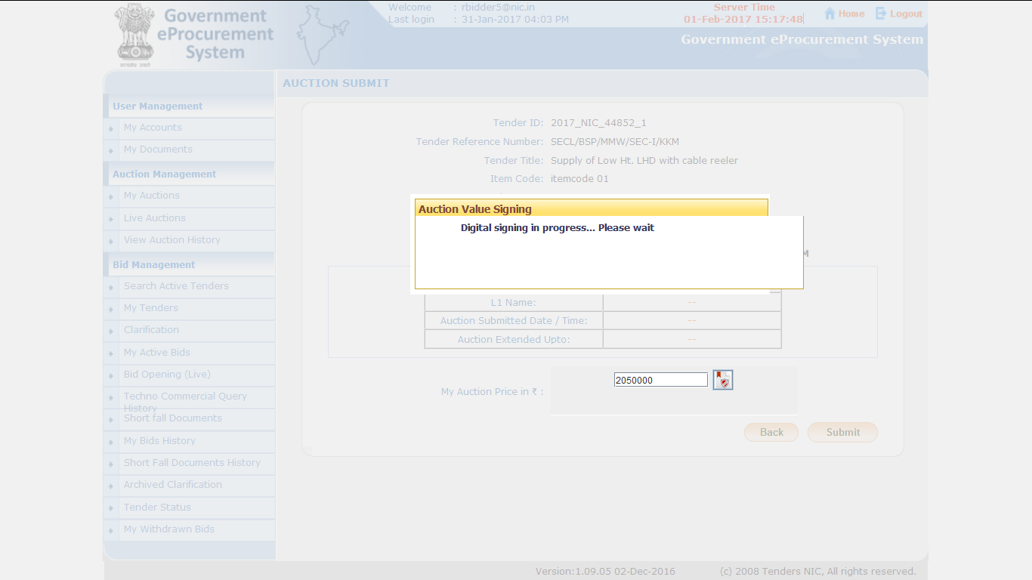

Slide 13
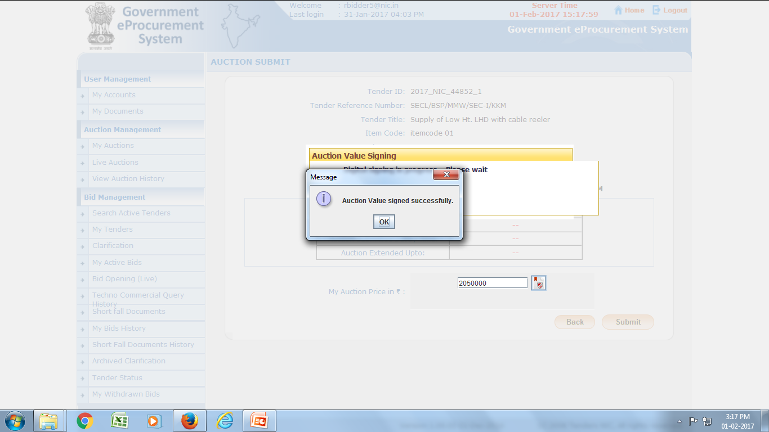
Click on OK

Slide 14
Submitting a value which is not in multiples of decremental value
Click on Submit

Slide 15
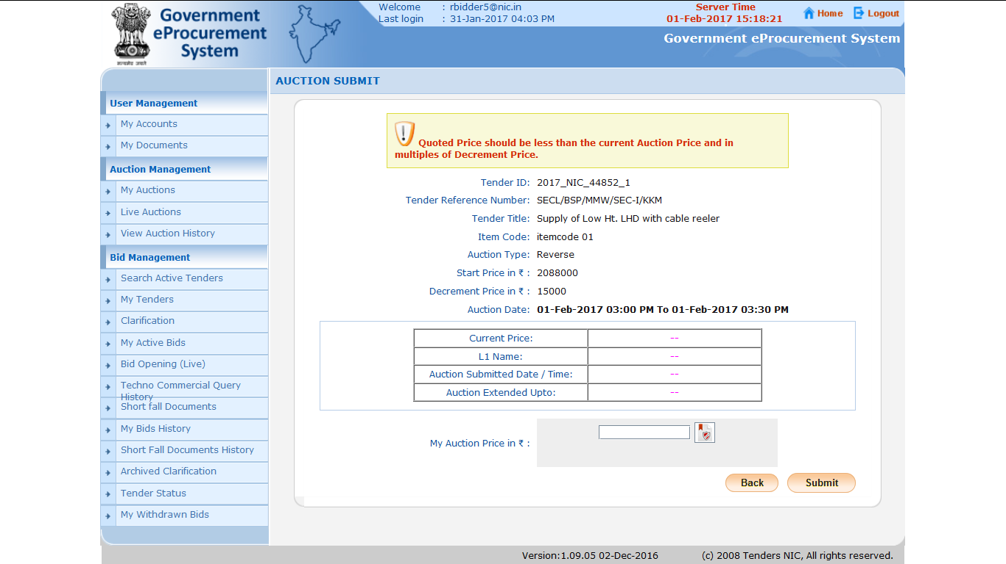

Slide 16
1.System showed error message
2. Now, Enter the Auction Price within the Limits and Digitally Sign

Slide 17
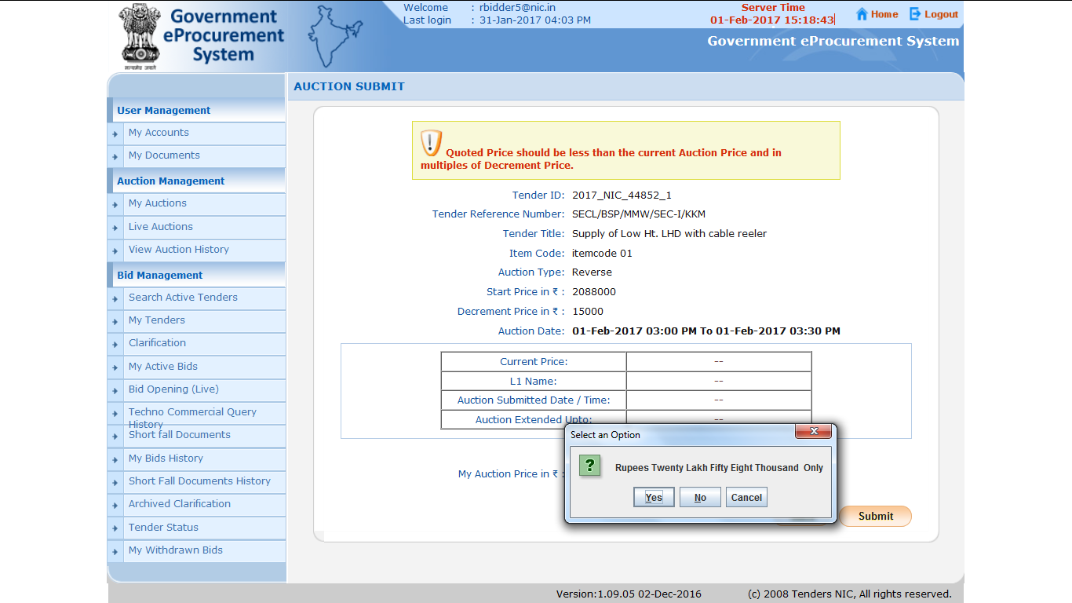
Click on ‘Yes’

Slide 18
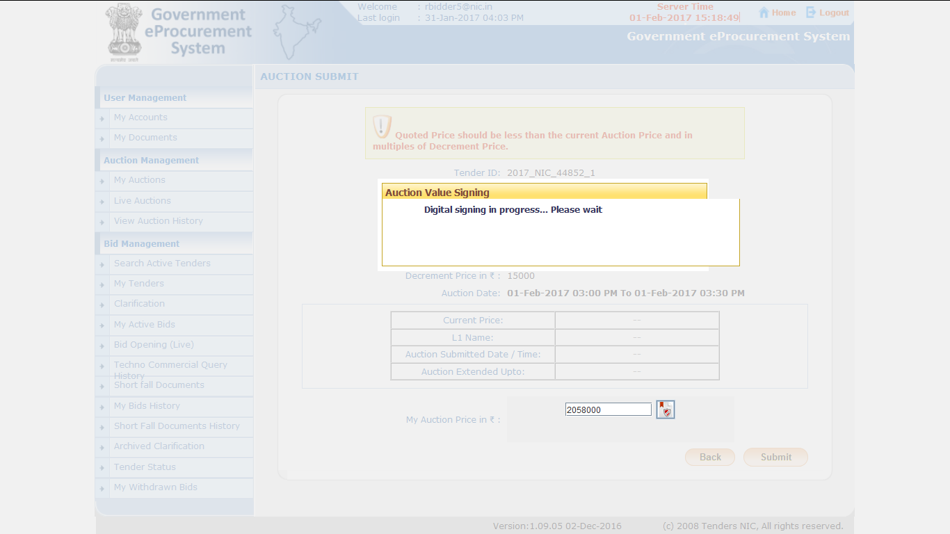

Slide 19
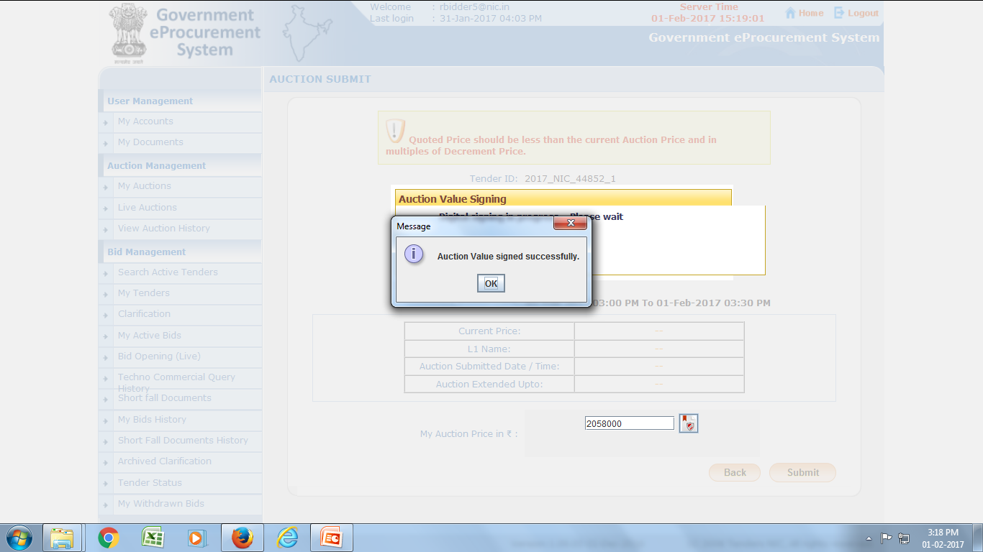
Click on OK

Slide 20
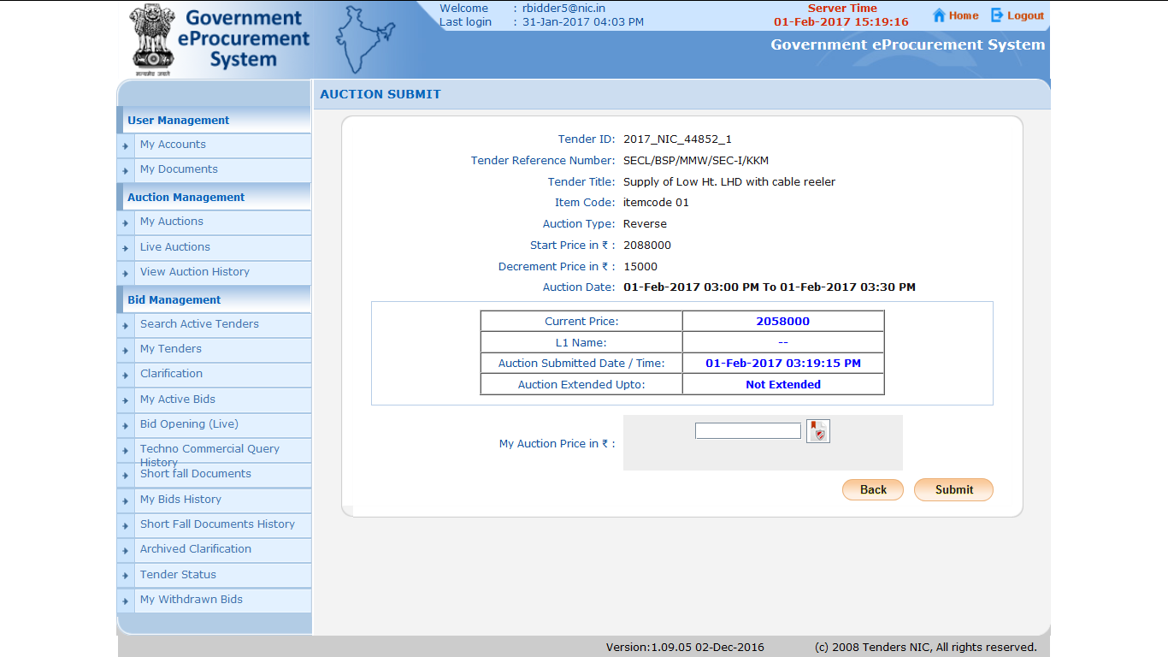
Now, the Current Price has been changed

Slide 21
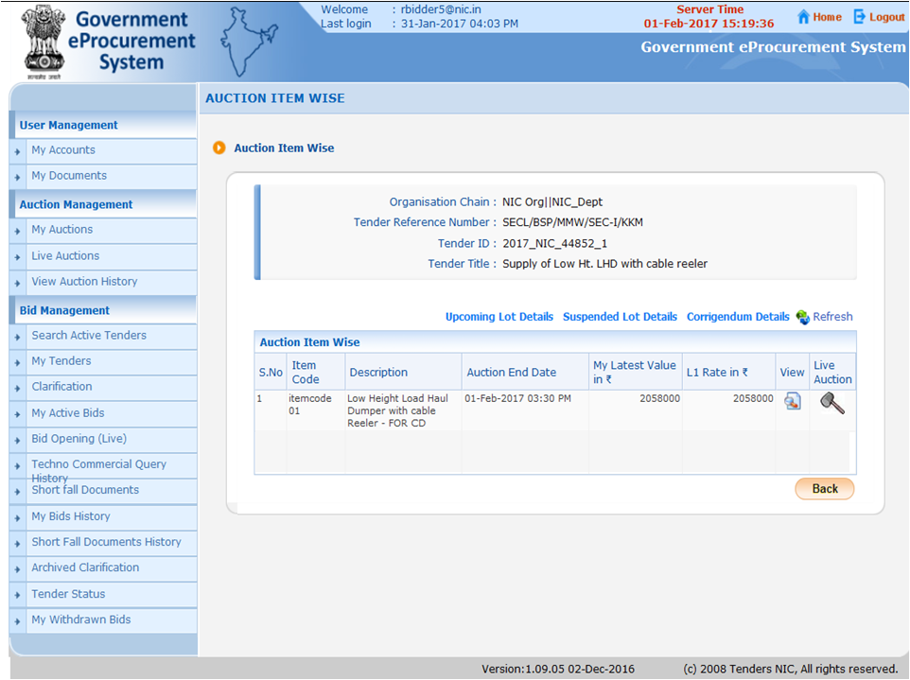
System will show your Latest Price Quoted
Here, Least Amount which any Bidder would have quoted is being shown

Slide 22
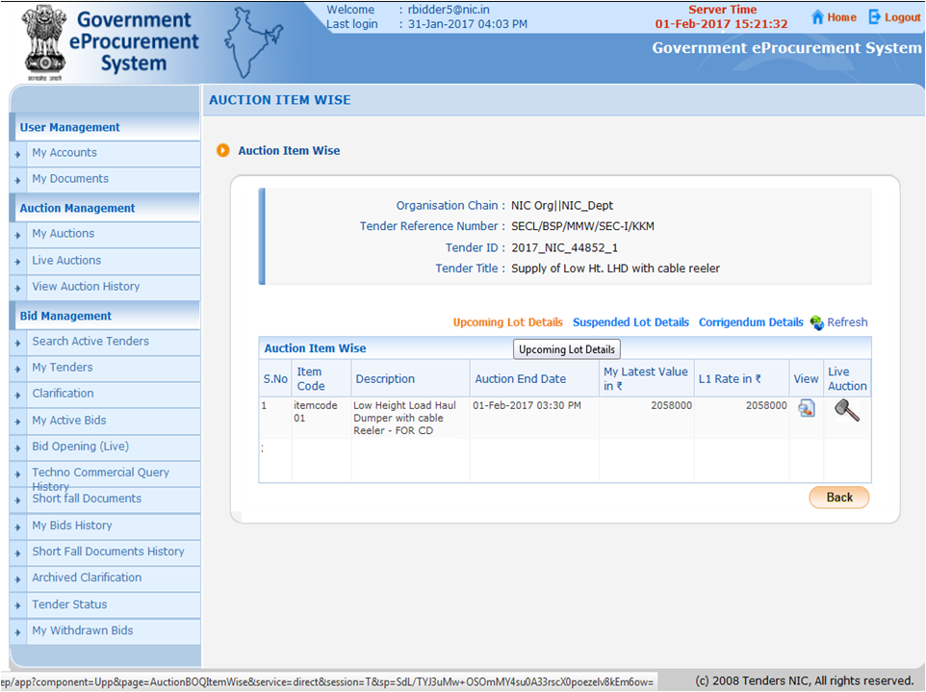
If there would be any other Lot for same Auction in future Time, it will be displayed under Upcoming Lot Details

Slide 23
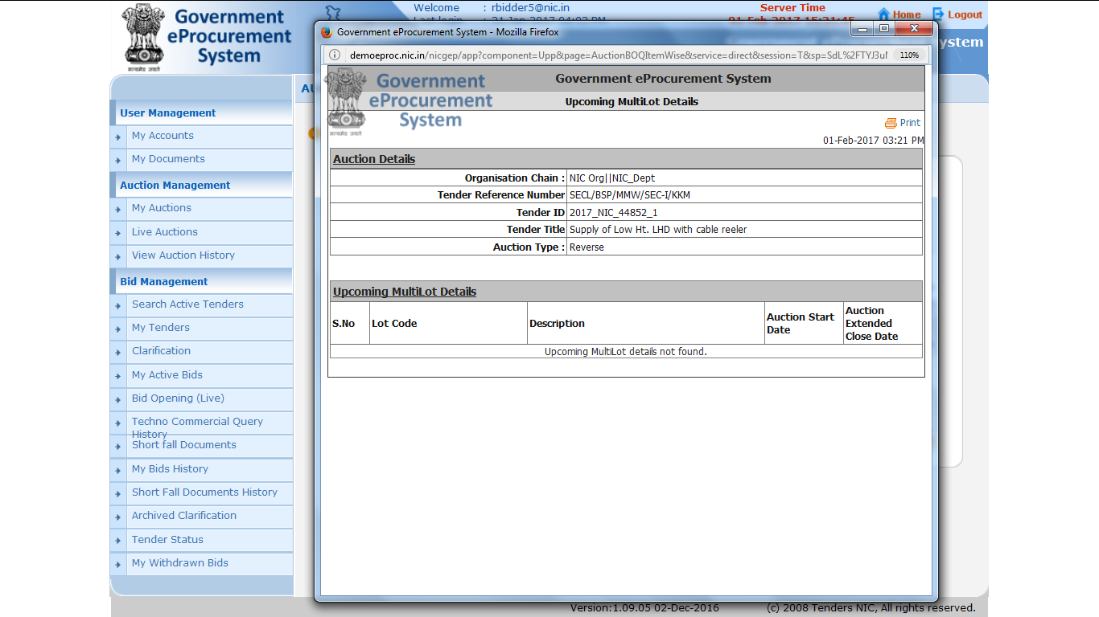
No Upcoming Lots in same Auction

Slide 24
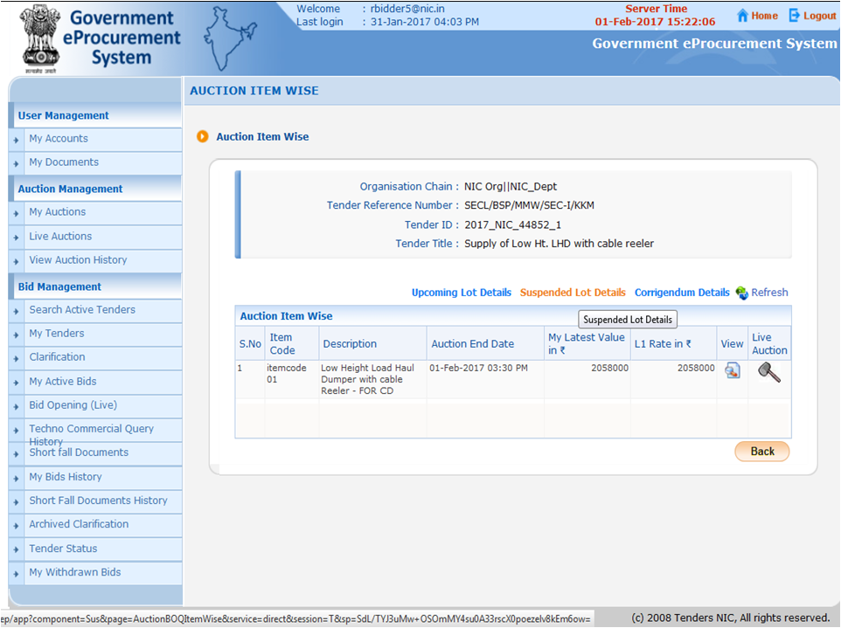

Slide 25
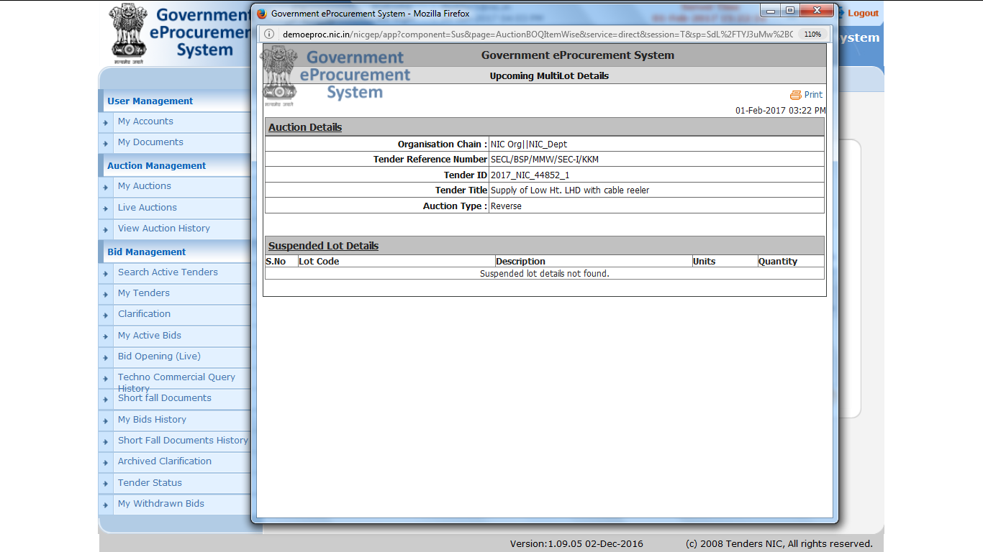

Slide 26
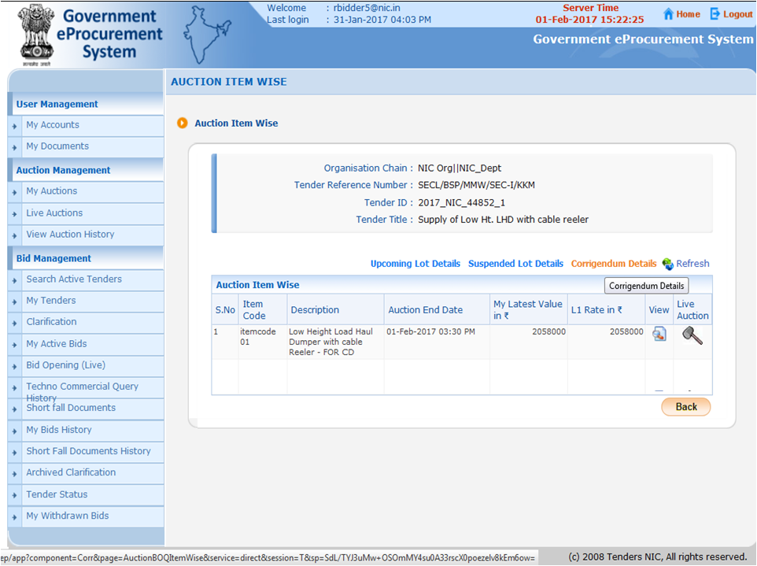

Slide 27
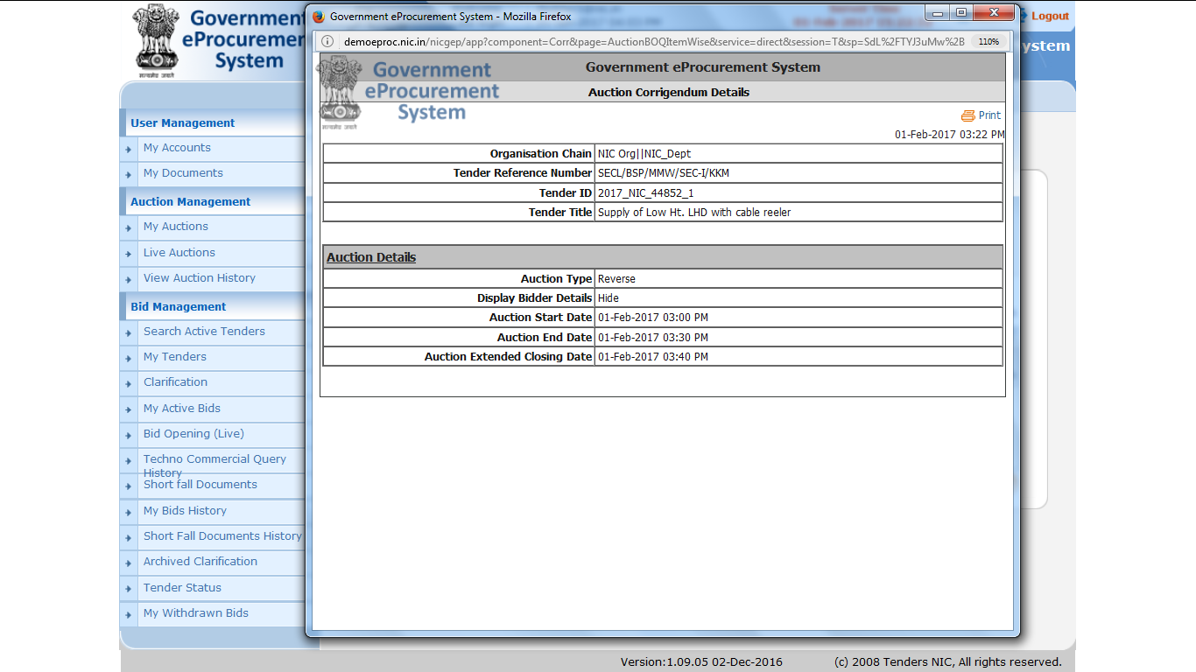

Slide 28
View Live Auction by Department User

Slide 29
Enter username, password and click on Login Button
Bid Evaluator logs in with his user Id /Password and DSC.

Slide 31
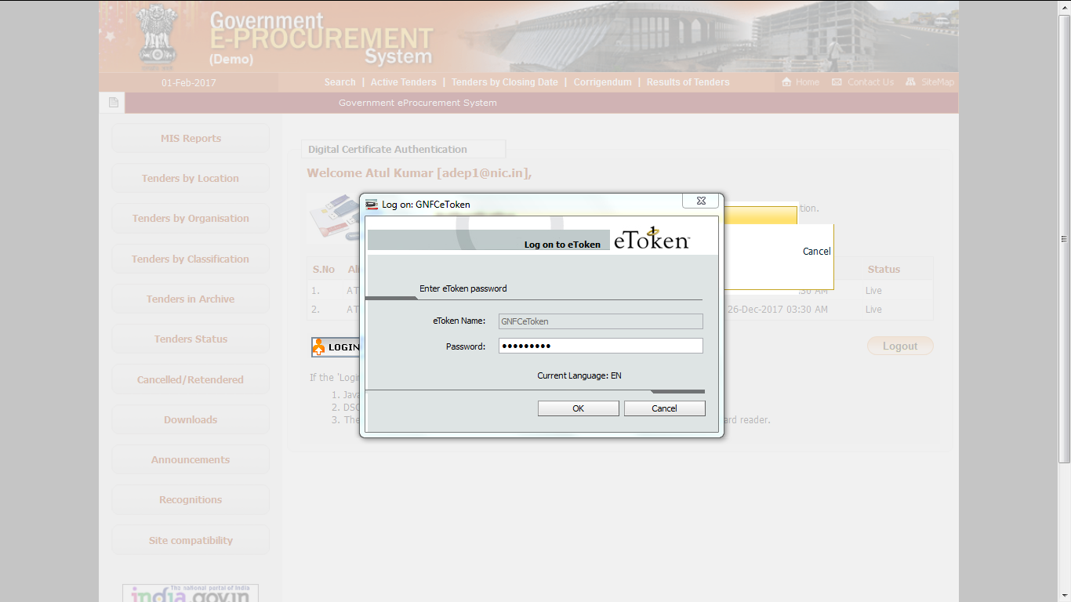
Enter DSC Password
Click on Ok

Slide 32
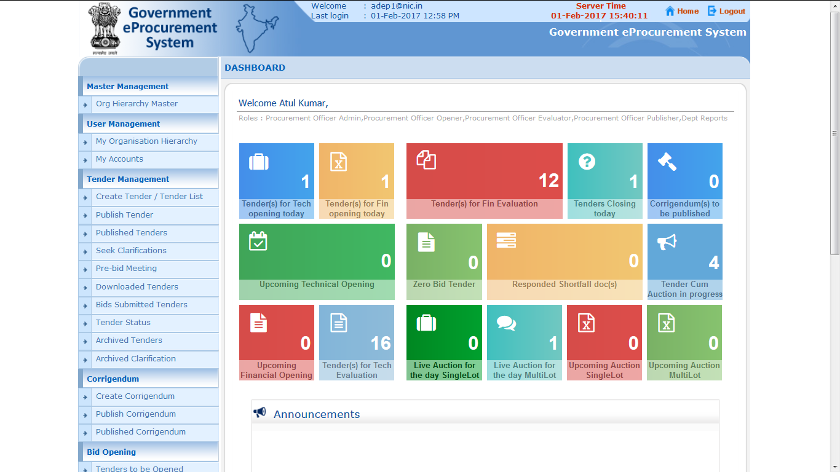
Role Based (Procurement Officer Admin(Creator)/ Publisher/ Opener / Evaluator) Dashboard will appear.

Slide 33
Click here to view Live Auction

Slide 34
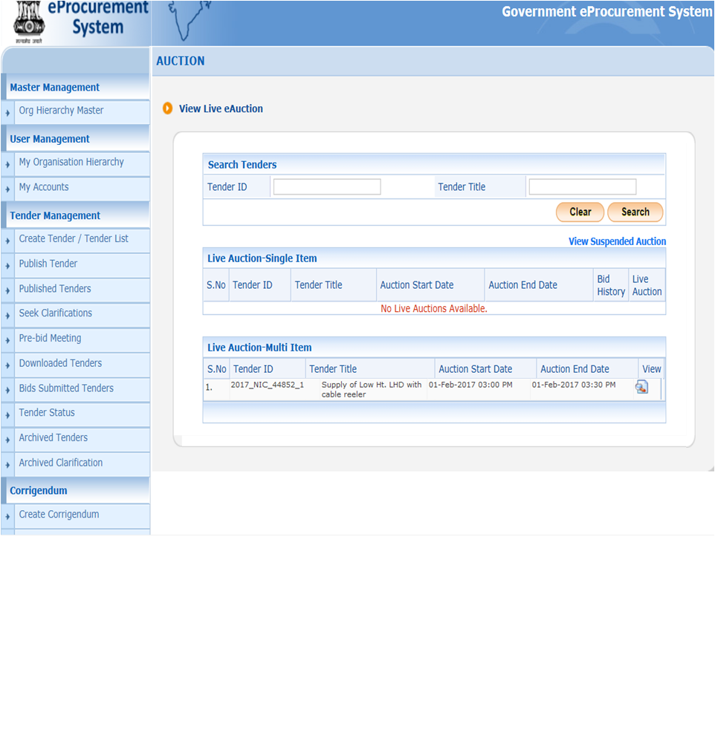
Click on view of a particular auction

Slide 35
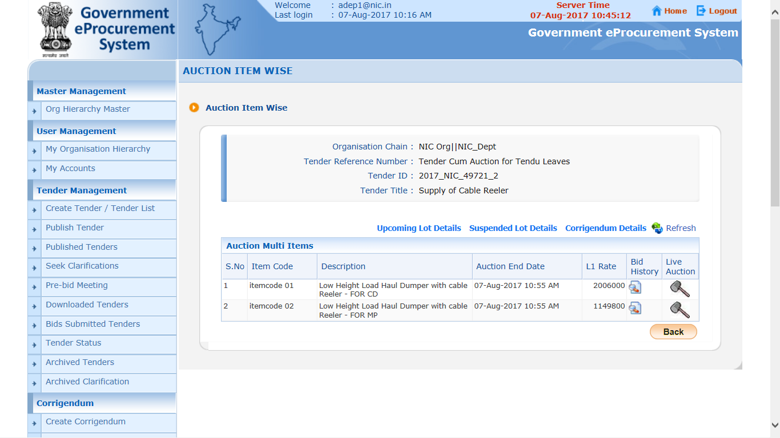
Click to view for Live Bid for particular Lot

Slide 36
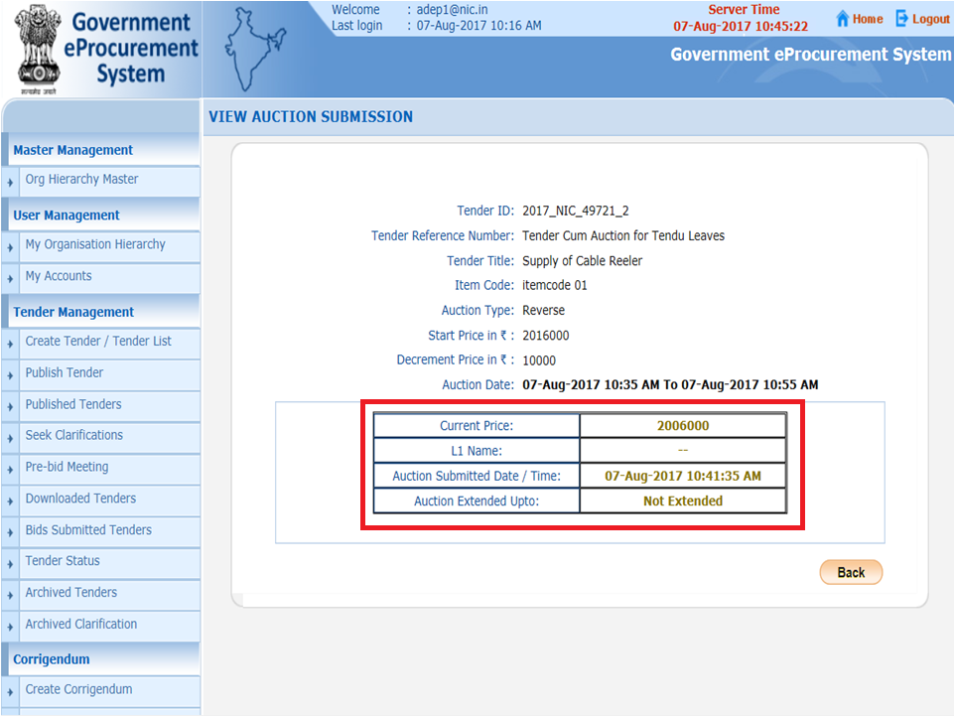

Slide 37
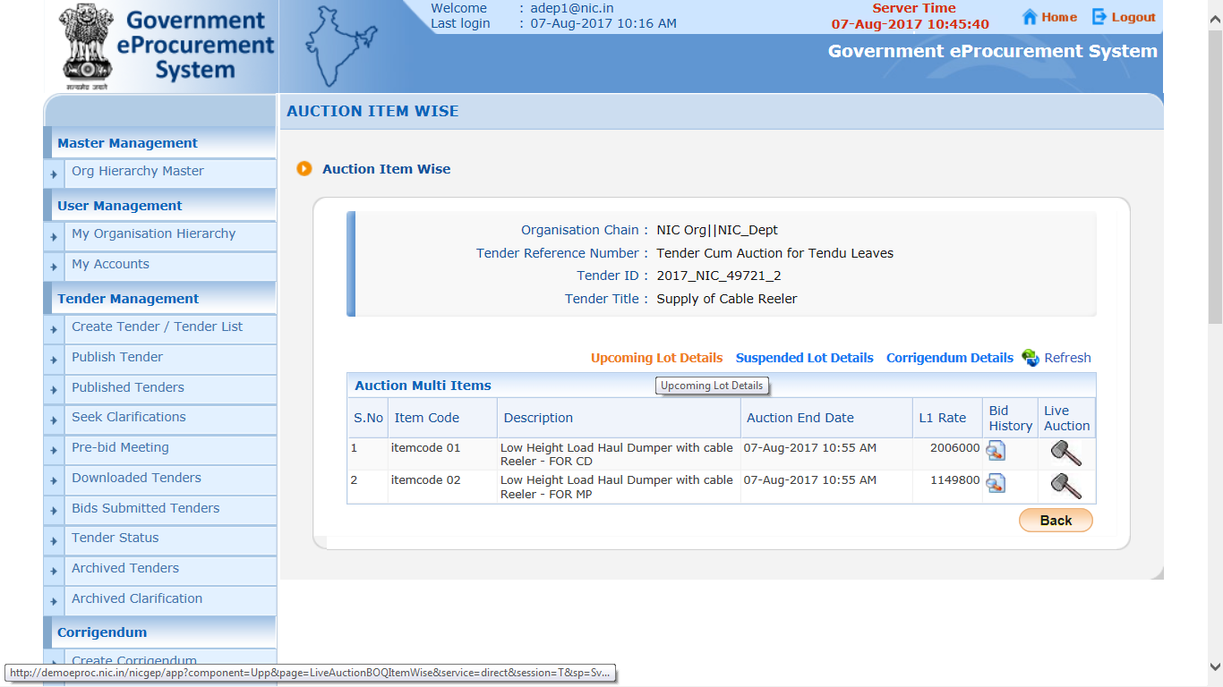
Click to view Lot Wise Bid History
Click to view Suspended Lot
Click to view Corrigendum Details
Click to view Upcoming Lot

Slide 38
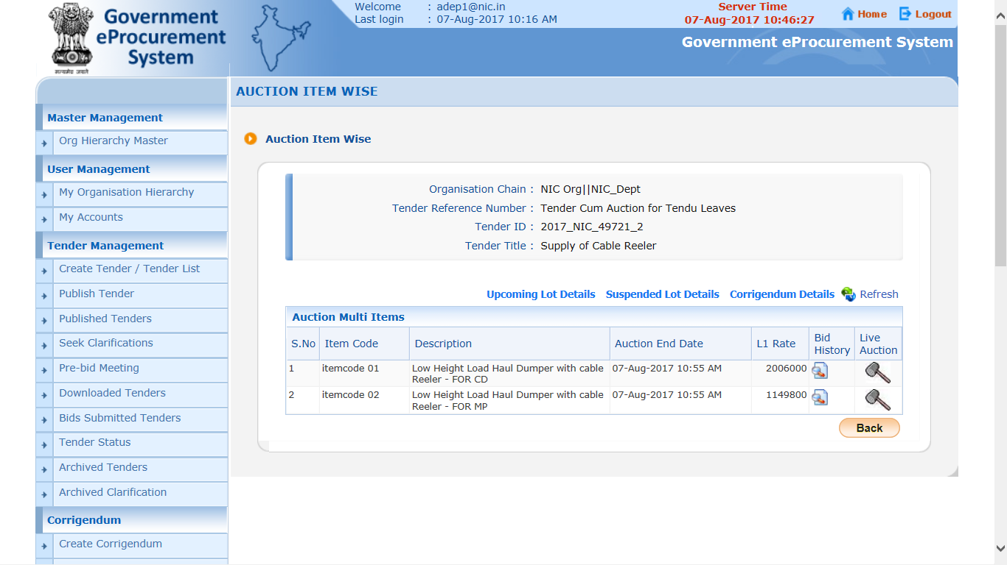
Click to view Lot Wise Bid History

Slide 39
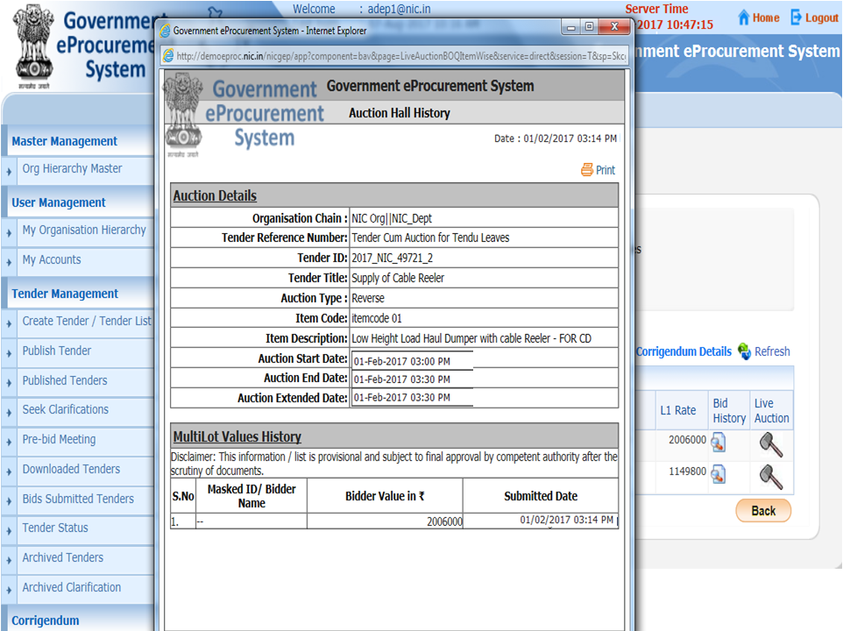
History Details

